Slide 1

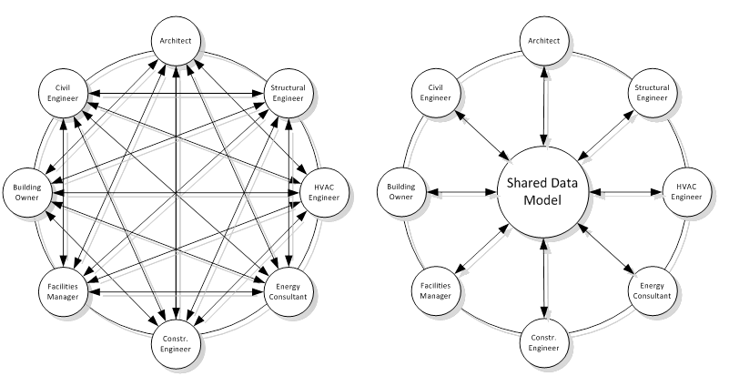
AIA TAP: Building Connections Congress
There is no central BIM model...
Léon van Berlo

Slide 2
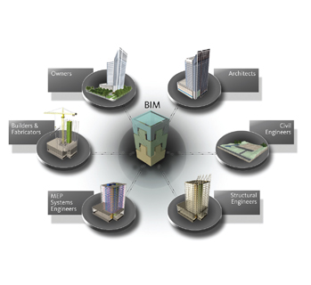
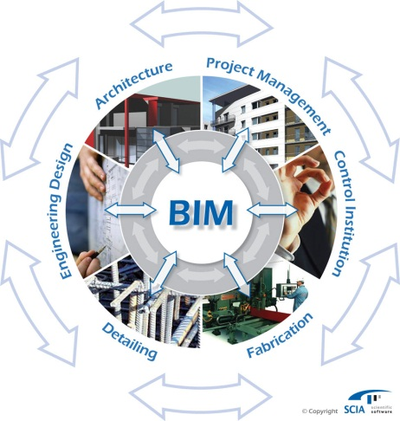
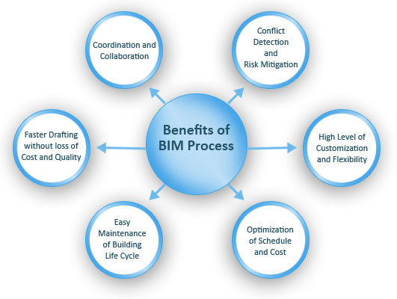
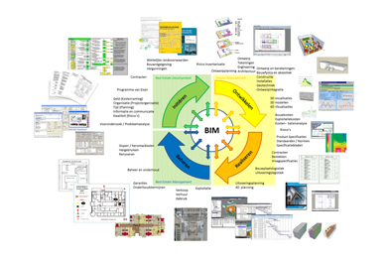
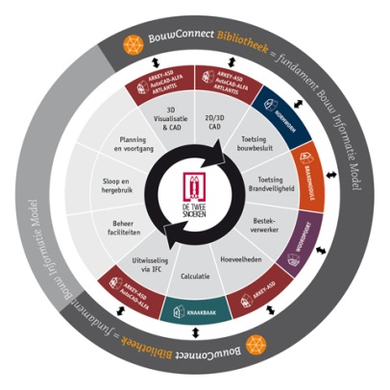
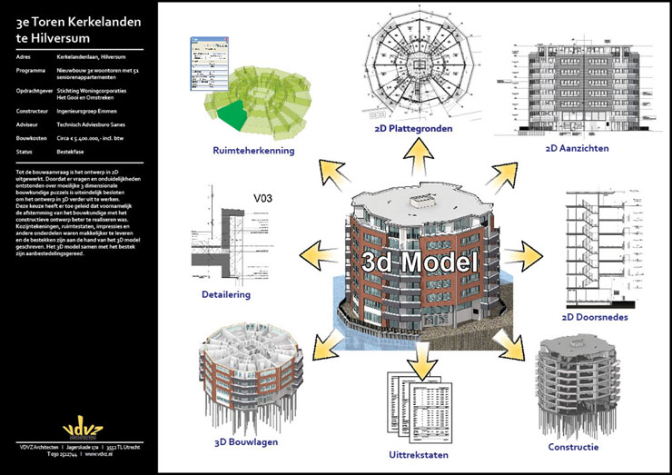
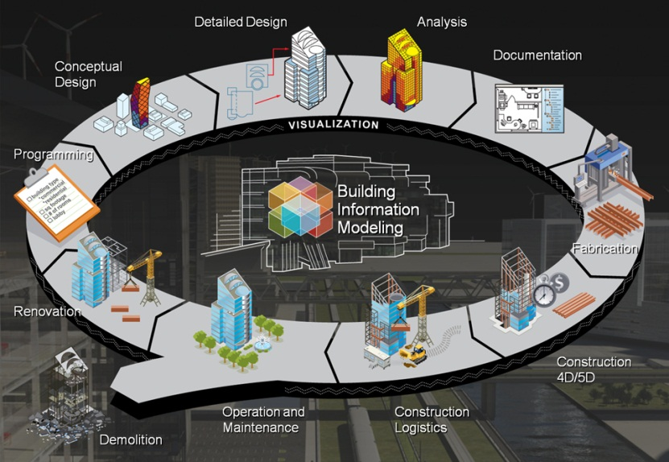
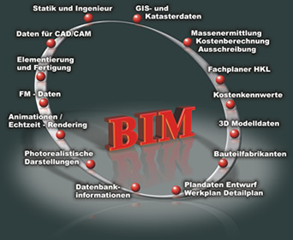

Slide 3


Slide 4
199?: Birth of “the central model”

Slide 6
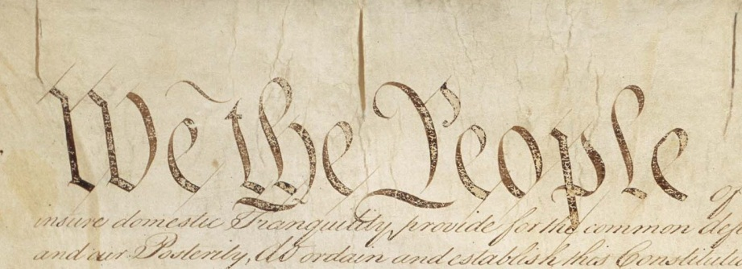
Misconception (misinterpretation):
Shared data model is NOT equal to:
Shared BIM model instance
Shared data
Shared data model comes from the need to share/distribute data in a standardized way…. “let’s agree to all do it like this”
shared data model == creating agreements (interoperability)

Slide 7
huh…? So why do we need a “central” model?

Slide 8

Why a ‘central modelserver’?
Sharing large files (data)…
What information do you share?
Where does it come from?
Merging / synchronization
Revision management
Alerts/notifications
Knowing who to blame
Etc… Lots of good reasons, but you know why!
Could be just a useful gadget…
…. like shoes with build in music players.

Slide 9
Ok, so which one should I choose? Which one is best as a ‘central’ server?
Huh? →

Slide 10
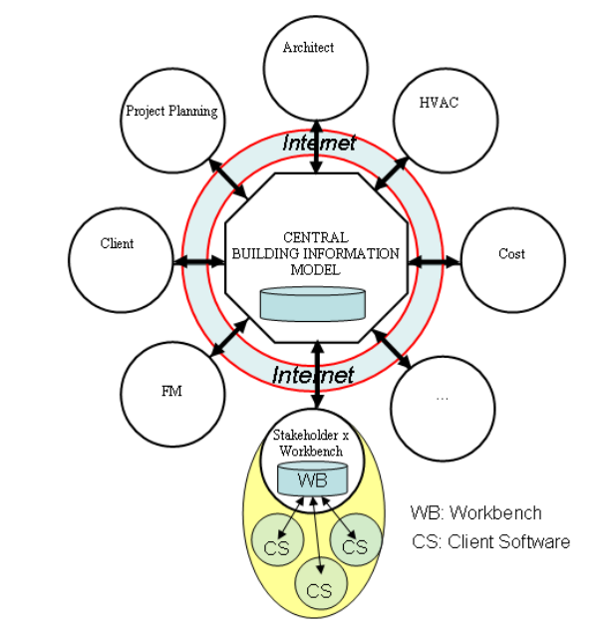
source: Nour

Slide 11
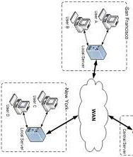







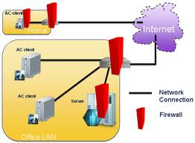

Slide 12
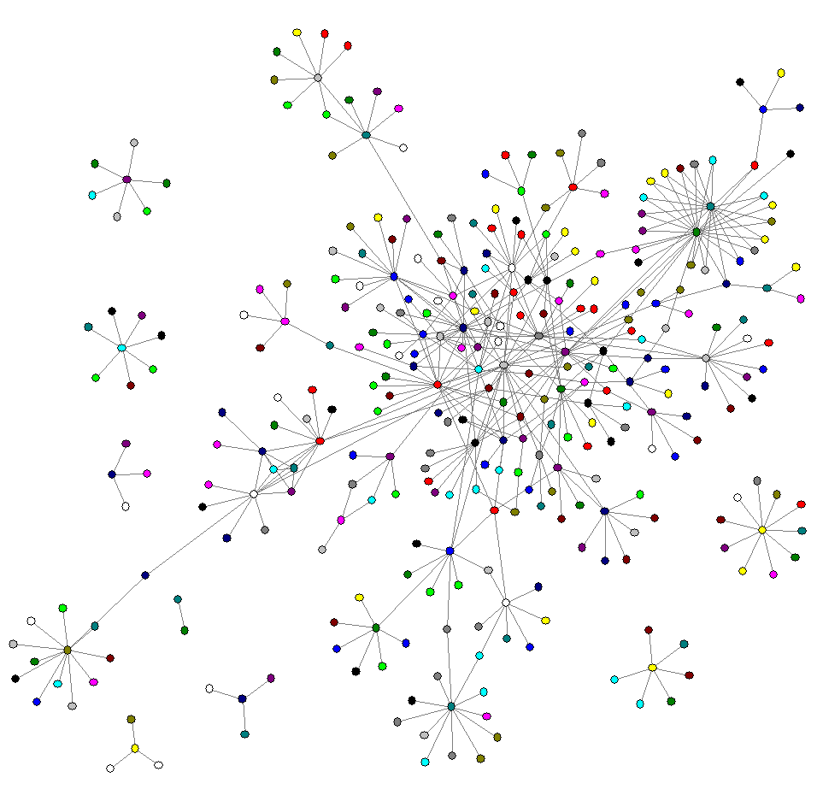

Slide 13
“There is no CENTRAL model” (there are shoes with integrated music players)

Slide 14
Proof?

Slide 15
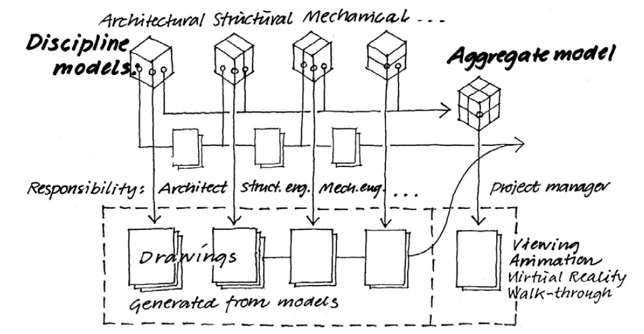

Slide 16
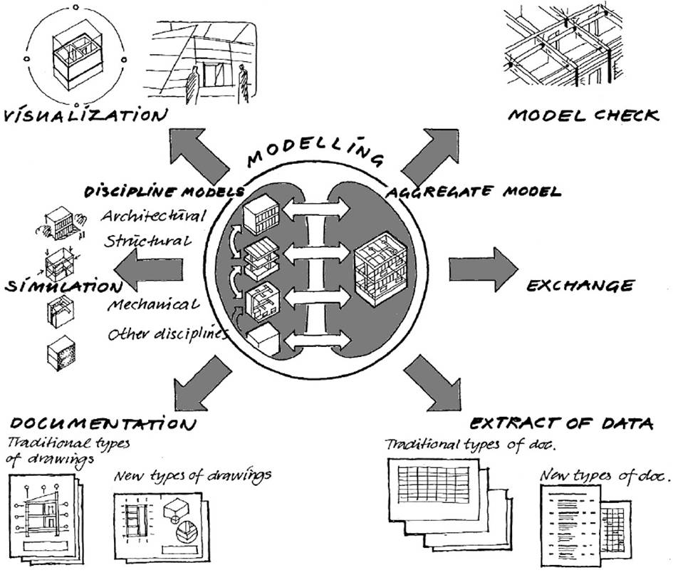
Denmark (June 2008):

Slide 17
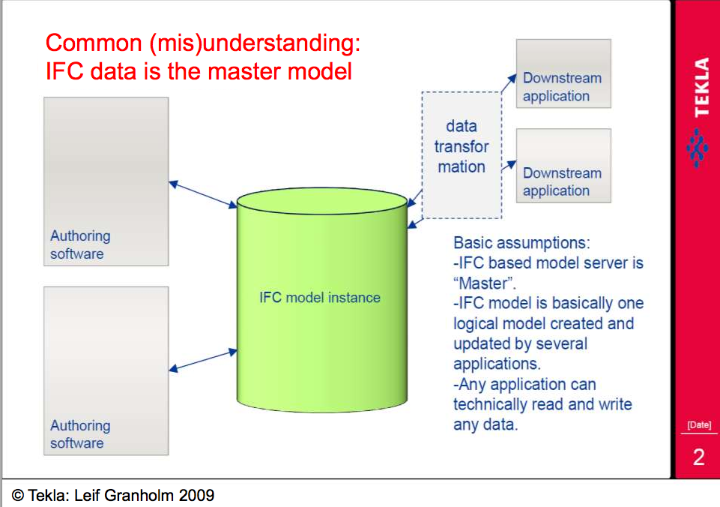

Slide 18
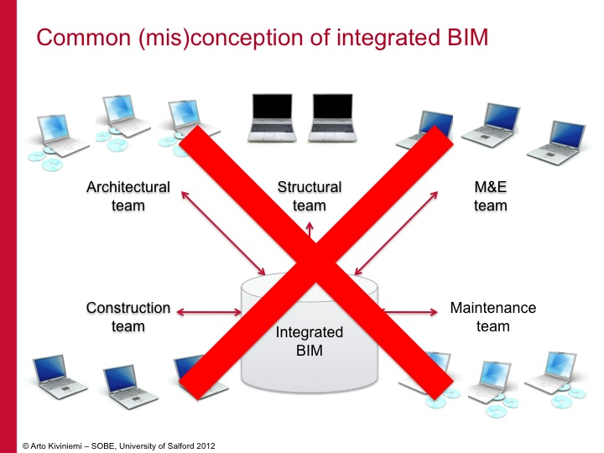

Slide 19
But ‘we’ (in the Netherlands) also know this...

Slide 20
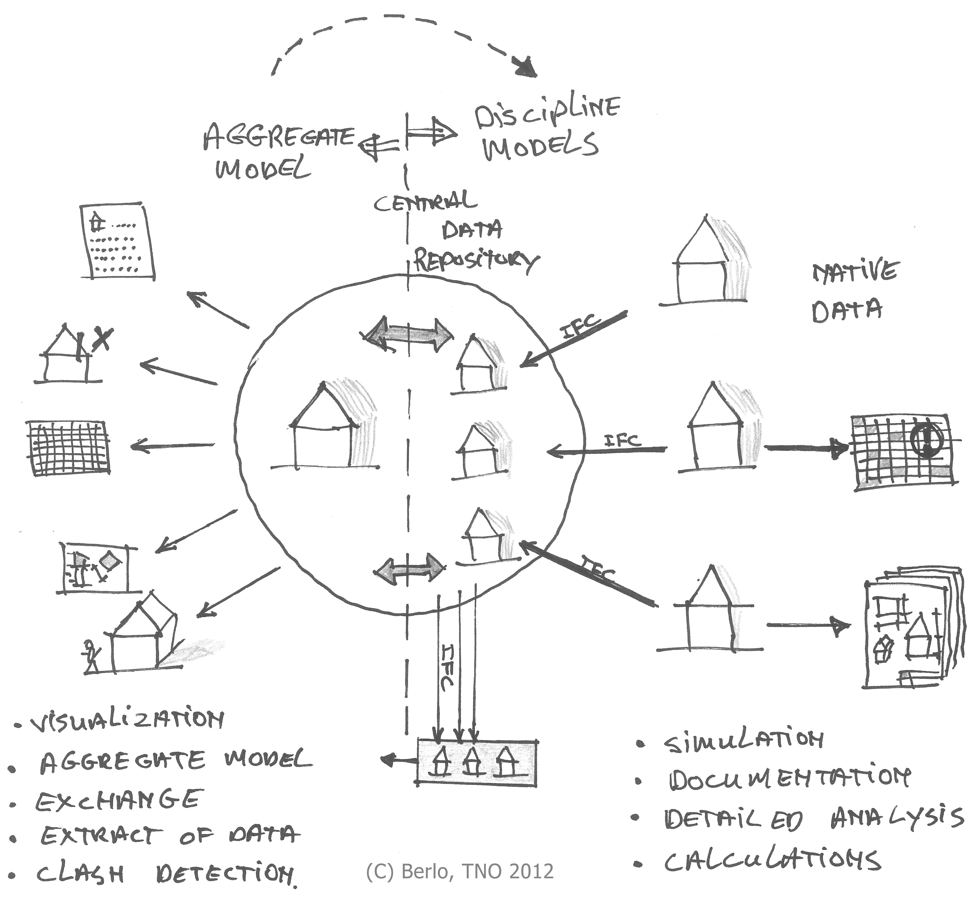
Our research:

Slide 21
Our research:
NO ROUNDTRIP
(import/export in a chain of tools)

Slide 22

Conclusion: The IFC data standard is stable and usable in an AEC collaboration environment IFC meets the needs of the industry (as described in the paper)

Slide 23
Other observations (skip this during presentation)
Users in the experiments in this research did not prefer a so-called ‘live synchronization’. The median of synchronization time of model instances was 1 week (every Friday was a widely used practice).
In a homogeneous software environment, users felt that all team members should have equal BIM software modeling expertise.
The use of a reference model concept with IFC can lower the needed BIM competences for a project partner to be able to collaborate in a way that is sufficiently effective for the entire project team.

Slide 24
Found conclusion: Working in a ‘central’ modelserver (everybody the same tool) has more downsides than advantages. (ownership of objects, data overload, legal, change requests, etc...)

Slide 25
Why do people still do it?

Slide 26
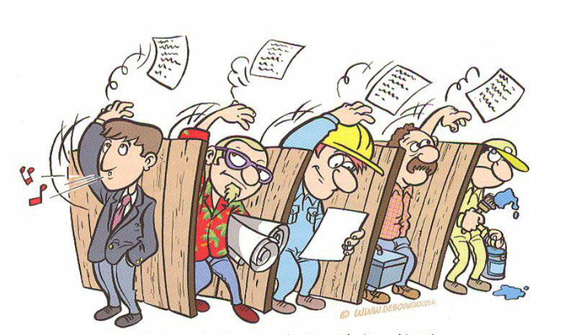
Why do people still do it? “It’s simple, easy and quick” “We just send/share everything we have”

Slide 27

The real question (which is difficult): What does the other person need to do his job? What do I need to do my job?

Slide 28
MVD
Model View Definitions
Are about defining the baseline to perform your job
Are about your core business…..
By the way: same goes for all the ‘ie’ standards!

Slide 29
And when you know your job, and you know what you need to do it……

Slide 30
...you don’t need a central modelserver at all.

Slide 31

There is no central BIM
leon.vanberlo@tno.nl
twitter.com/berlotti

